Slide 1

Building Trust in Educational AI through Factuality Verification​
Data Jackets

Slide 2
Agenda
Testing
2

Slide 3
Business Problem
1. Business Problem Framing
LLM hallucinations affect user trust and adoption of educational AI tools.​
Supporting Data:​
Strong negative sentiments associated with hallucinations ^{[1]​}
More than 50% of surveyed students are concerned ^{[2]​}
People becoming more cautious and selective in using AI ^{[3]​}
3

Slide 4
Stakeholder Analysis
1. Business Problem Framing
Stakeholder​ | Primary Concern​ | Secondary Concerns​
Students​ | Reliable responses ^{[4]​} | Price and speed​ ^{[7]​}
Educators​ | Limiting misinformation ^{[5]​} | Product accessibility​ ^{[8]}
Platforms | Reputational risk ^{[6]​} | Product competitiveness ^{[9]}
4

Slide 5
Problem Formulation
1. Business Problem Framing
How can we increase user trust in educational AI tools by accurately, quickly and cost-effectively identifying erroneous/ irrelevant (“hallucinated”) LLM responses within the next two months?
Primary Metric: Accuracy
Secondary Metric: Cost and Speed
5

Slide 6
Analytics Problem
2. Analytics Problem Framing
Inputs: | Question + Context + Answer
Output:​ | Label (factual/ contradiction/ irrelevant)
Analytics Problem: | Predictive Problem Text Classification based on Factuality and Relevance
Assumptions: | Context is relevant to the question.​ The question has an answer.​
Constraints: | Limited time, compute resources​ Zero financial expenditure​
Risk Mitigation: | Class imbalance → Balanced accuracy​
6

Slide 7
Metrics and Goals
2. Analytics Problem Framing
Primary Metric: Balanced Accuracy
Secondary Metrics: Average Time and Cost per Row
 | Balanced Accuracy | Average Time | Average Cost
Baseline​ | 33.3% | 0ms | 0ms
Target | 95.0% | FILL IN | FILL IN
Stretch Goal | 99.5% | FILL IN | FILL IN
7

Slide 8
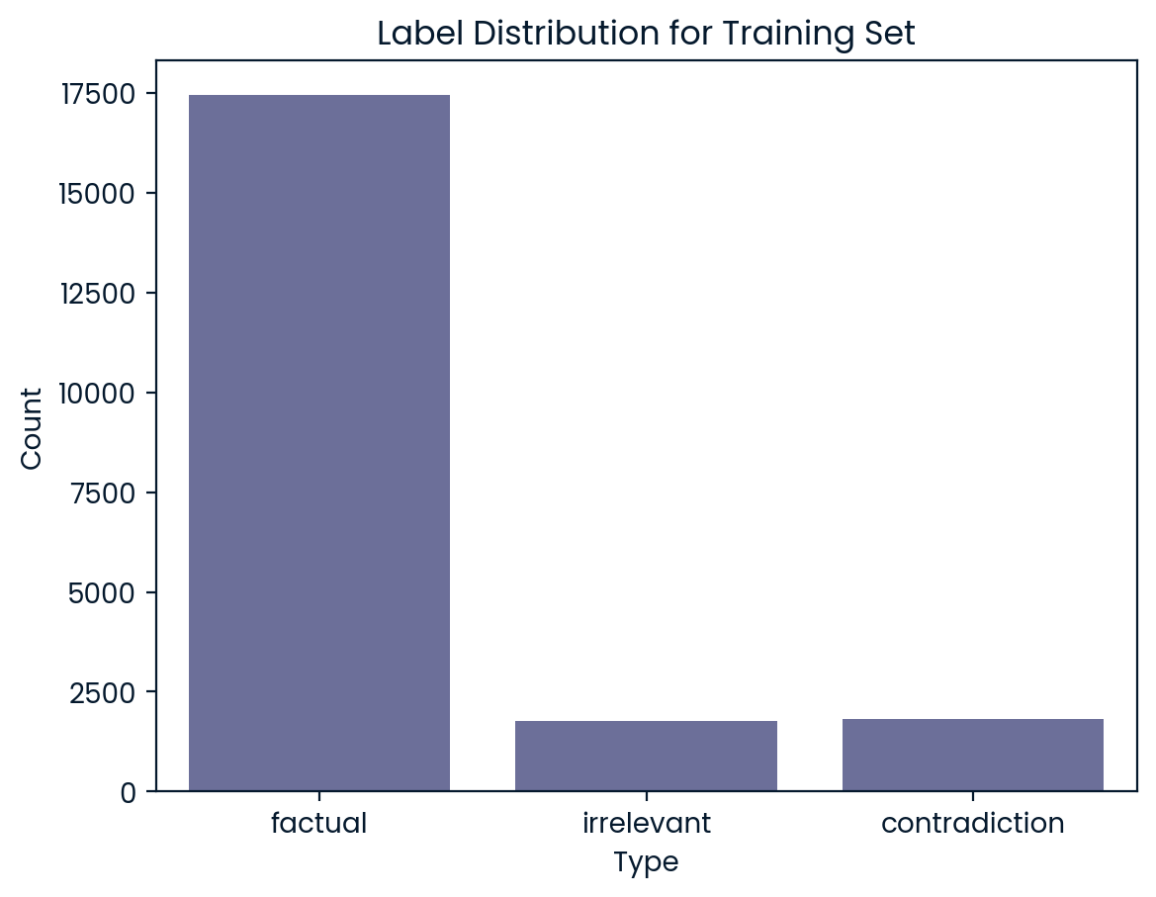
Overview of Data
3. Data
21,021 training samples
2,000 held-out test samples
No ethical issues involved
Strong class imbalance in the training set
8

Slide 9
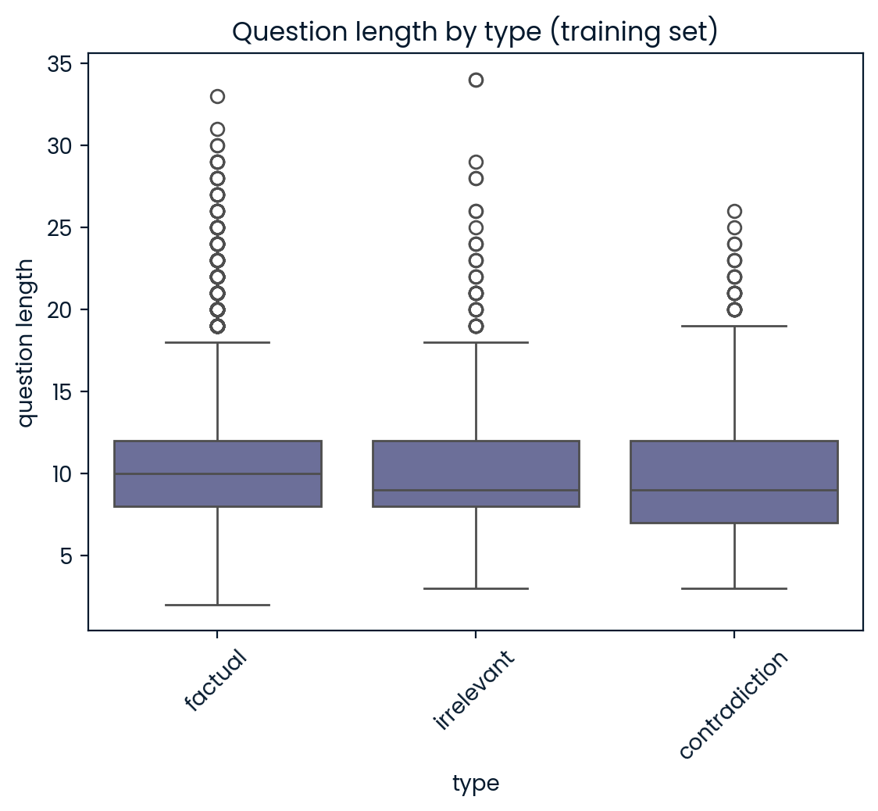
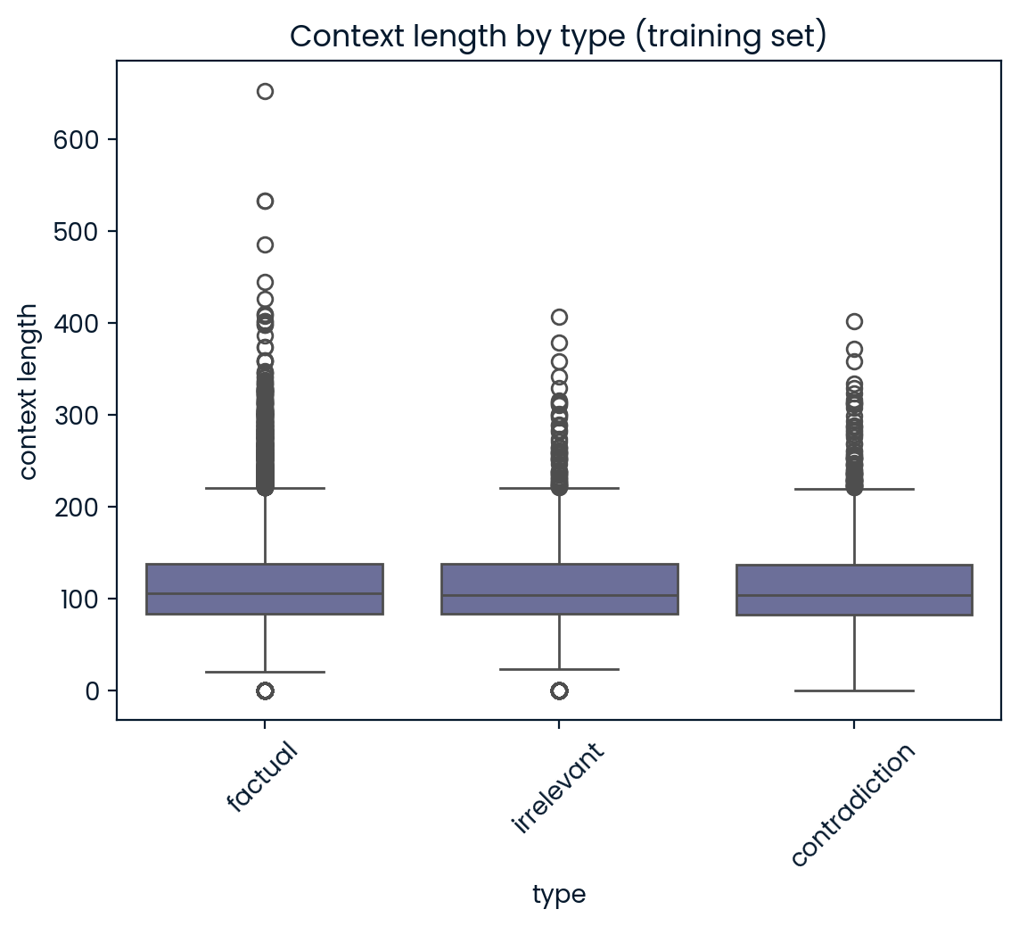
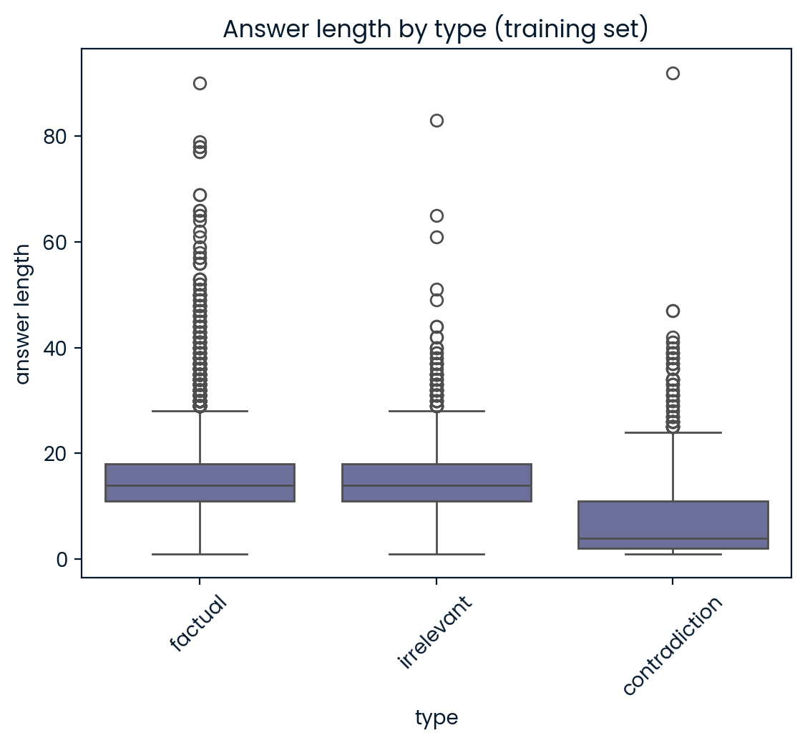
Length-Based Analysis
3. Data
Answers for contradictions are significantly shorter than factual/ irrelevant types
9

Slide 10
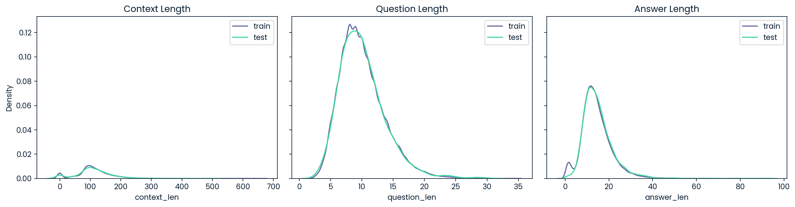
Train-Test Drift
3. Data
Length-based feature distributions are similar, except that the training set includes many short answers absent from the test set
10

Slide 11
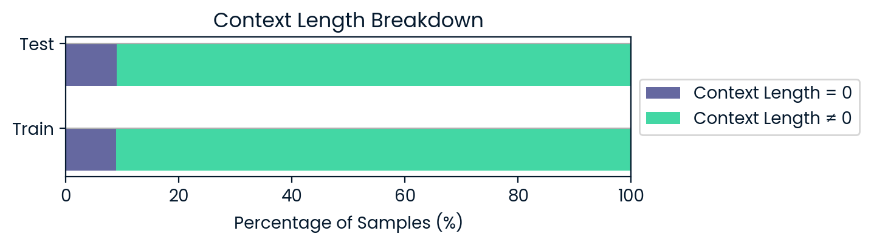
Context Adequacy
3. Data
A significant minority (~8-9%) of data in both datasets have no context
All nonzero contexts with < 25 words were manually checked for adequacy
11
Notes:
35 in train set, 2 in test set

Slide 12
Initial Approach
4. Methodology Selection
Cite some past literature on semantic similarity for factuality detection
Derived semantic similarity between the question, answer and context
Expectation:
Factual answer shares keywords with question and context → high similarity
Irrelevant answer is misaligned with question and context → low similarity
Contradictory answer → somewhere in between
12

Slide 13
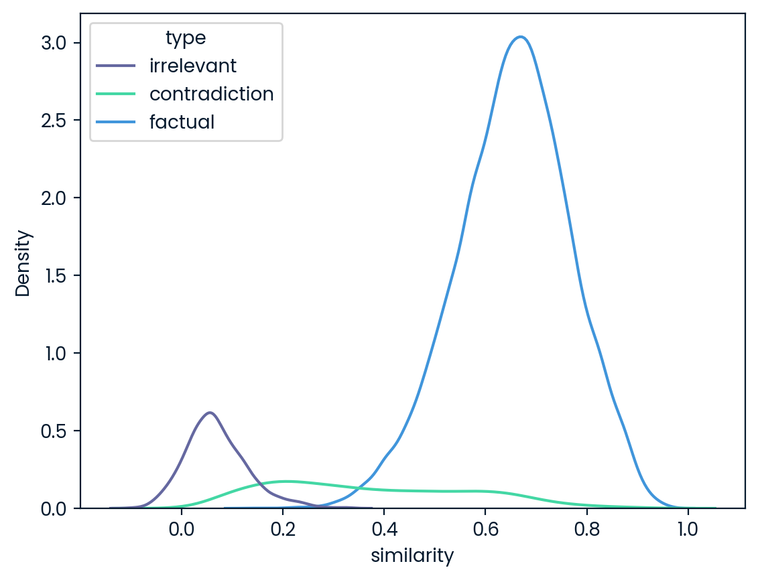
Results from EmbeddingGemma[] Model
4. Methodology Selection
13
Notes:
We can see a neat separation between the irrelevant and factual responses, but the similarity scores of the contradictions span a wide range of values.

Slide 14
Explanation of Results
4. Methodology Selection
Short answers (eg. "six months", "2") have minimal semantic similarity with the question and context.
They just happened to be predominantly contradictions in the training set.
14
Notes:
We can see a neat separation between the irrelevant and factual responses, but the similarity scores of the contradictions span a wide range of values.

Slide 15
Explanation of Results
4. Methodology Selection
Answers to questions with empty contexts yielded high similarity scores even when they were contradictory.
There is no context to counterbalance the semantic alignment between the question and answer.
15
Notes:
We can see a neat separation between the irrelevant and factual responses, but the similarity scores of the contradictions span a wide range of values.

Slide 16
Reframing the Analytics Problem
2. Analytics Problem Framing
Cases with context:
Evaluate answer factuality/ relevance with respect to the question + context.
Cases with no context:
Evaluate answer factuality/ relevance with respect to the question + external knowledge.
16

Slide 17
Final Approach
4. Methodology Selection
Cite some past literature on MNLI inference & LLM-as-a-judge for factuality detection
We need to reason about factuality and relevance
Our approach incorporates:
MNLI Model | Premise-Hypothesis structure allows logical reasoning Premise = Context + Question | Hypothesis = Answer
LLM-as-a-judge | LLMs have strong semantic reasoning capabilities
17

Slide 18
Data with No Context
4. Methodology Selection
Additional procedures were applied to no-context cases:
MNLI Model | Context augmentation from an external source
LLM-as-a-judge | Modified LLM prompt with amended decision rule
18

Slide 19
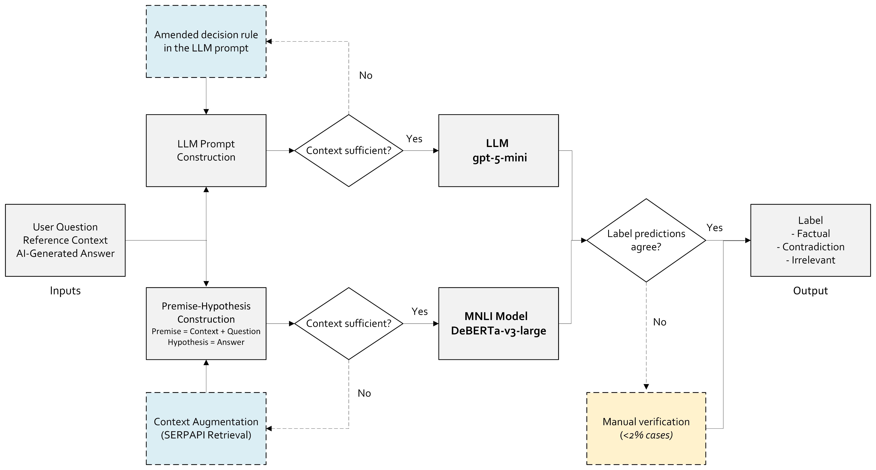
Final Pipeline
5. Model Building
19

Slide 20
MNLI Model
5. Model Building
20

Slide 21
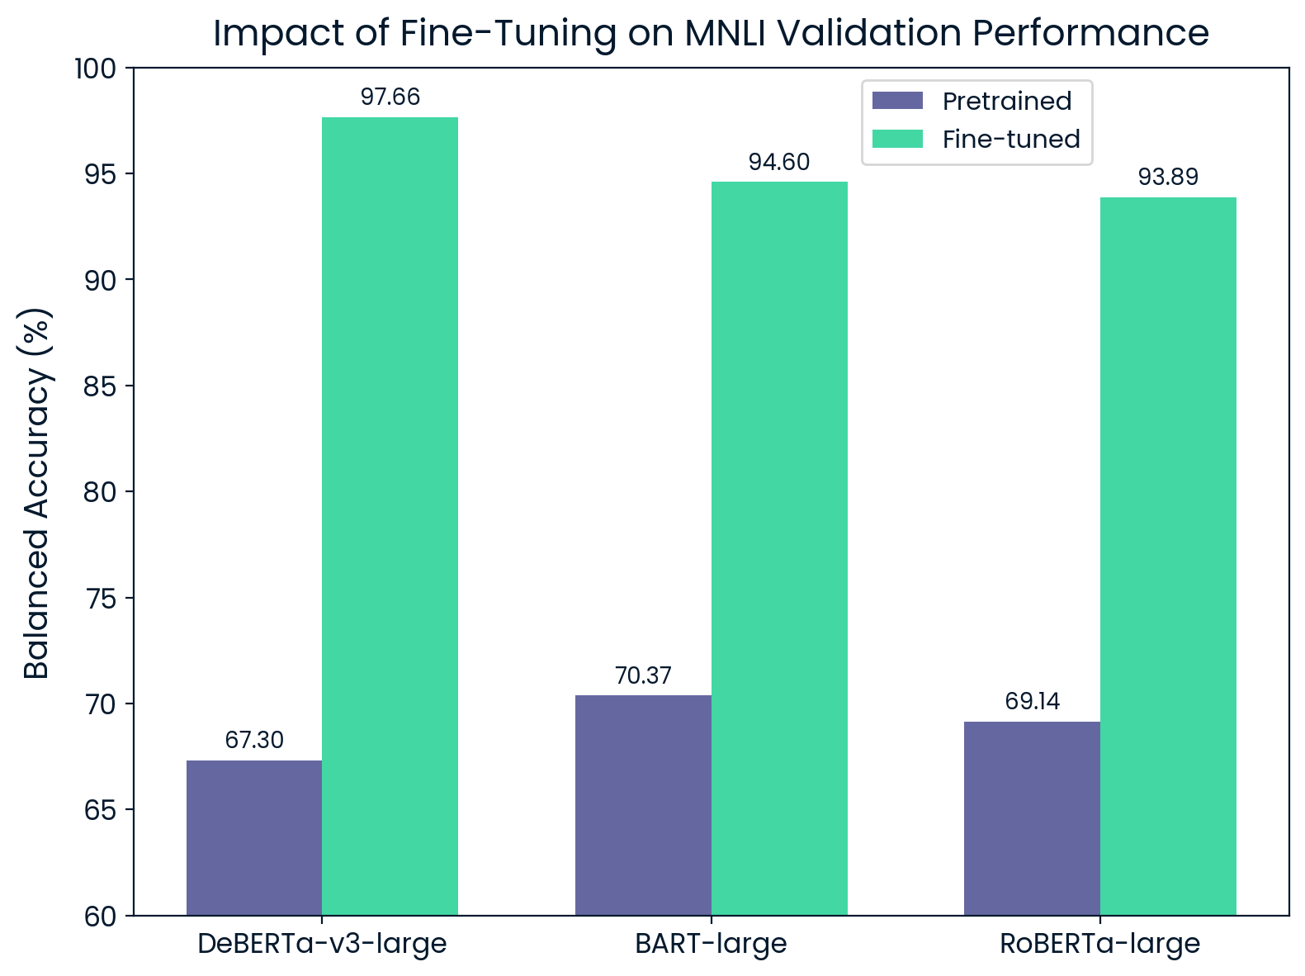
MNLI Model Selection
5. Model Building
Procedure:
Stratified 80/10/10 split of train set
We compared validation performance (balanced accuracy) of several pretrained and fine-tuned models
Results:
Fine-tuned DeBERTA-v3-large gave the best validation performance
Unbiased test accuracy: 97.70%
Fine-tuning yields ~25-30% gains
For the final competition submission, models were retrained on the full training dataset.
21

Slide 22
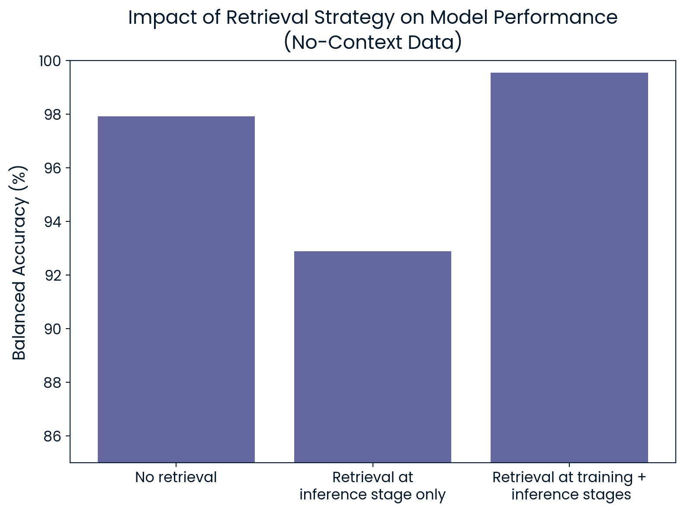
Context Augmentation with SERPAPI
5. Model Building
Procedure for no-context data:
We passed in the question as a search query and retrieved the first paragraph of Google Search Overview result
We then compared performance of different strategies on the test split
Results:
External retrieval (SERPAPI) helps only when model is trained on it
Retrieval-aware training exposes the model to similar input distributions
99.56​
97.92​
92.89​
22

Slide 23
Large Language Model
5. Model Building
23

Slide 24
LLM Selection
5. Model Building
Procedure:
LLMs were prompted to classify data with clear decision rules (modified for the cases with no context)
Ran LLMs on 5,000 rows for validation, and 5,000 rows for a test estimate
Results:
Azure OpenAI’s gpt-5-mini gave the highest FILL IN validation accuracy
Unbiased test accuracy: FILL IN
DO ANALYSIS
24

Slide 25
Ensemble
5. Model Building
25

Slide 26
Confusion Matrices
5. Model Building
Justification for the ensemble
Both approaches independently make classifications
26

Slide 27
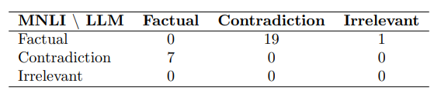
Ensemble Approach
5. Model Building
Procedure:
Both models were run on the test split
MNLI/LLM disagreements were identified
Results:
Model disagreements in <2% of cases​ necessitating human review
Disagreements are dominated by factual ↔ contradiction flips​
Balanced accuracy after ensemble approach rises to TO FILL IN
27

Slide 28
Final Results
5. Model Building
 | Balanced Accuracy | Average Time | Average Cost
Competition Results | 99.03% | FILL IN | FILL IN
Target | 95.0% | FILL IN | FILL IN
Stretch Goal | 99.5% | FILL IN | FILL IN
28

Slide 29




Overview of AI Services Used
5. Model Building
Azure OpenAI
(LLM)
Hugging Face
(NLI Models)
Google Colab & Kaggle
(GPU)
29

Slide 30
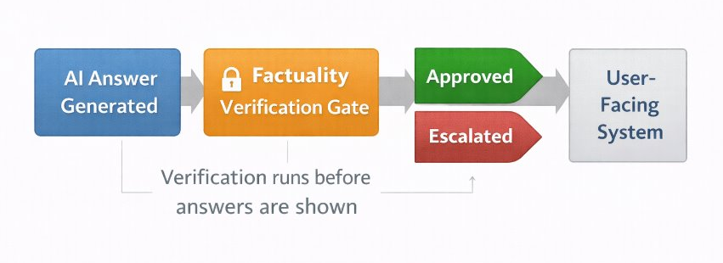
High-Level Process Diagram
6. Deployment
<2%
Verification acts as a gate, ​not just a diagnostic tool
Model needs to learn to deal with "messy" data (eg. context is not relevant to question, question is not answerable)​. Additional fine-tuning will be required.​
Validation can be done through user ratings of AI responses
30

Slide 31
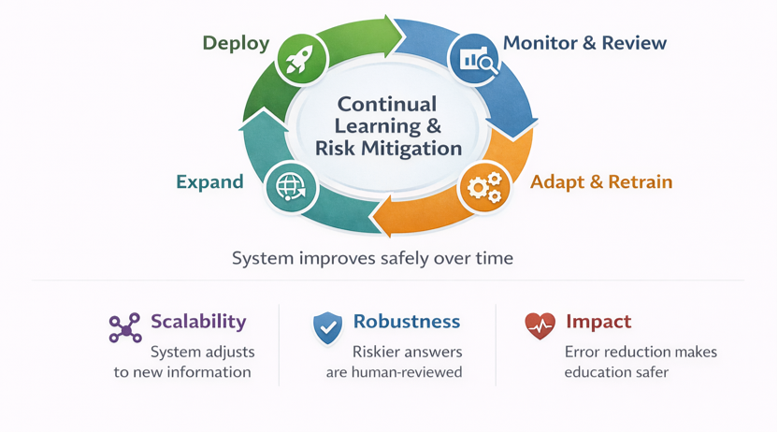
High-Level Process Diagram
7. Life Cycle Management
31

Slide 32
References
Testing
32

Slide 33
Appendix​

Slide 34
Context/ No-Context Breakdown
5. Model Building
Performance of fine-tuned DeBERTA-v3-large on test set:
With Context | Without Context
TO FILL IN | TO FILL IN
Context retrieval from an external source
19

Slide 35
LLM Prompts
Testing
2

